Slide 1
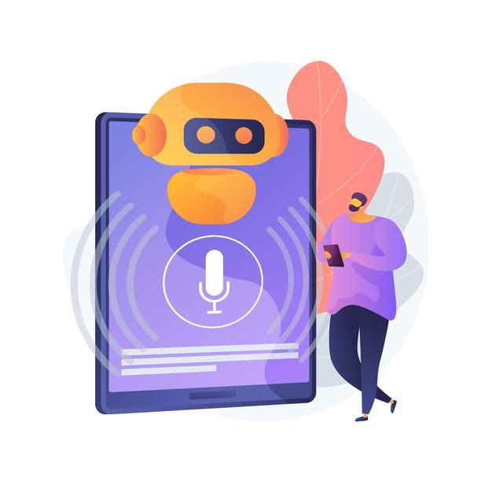
Virtual Assistant Jack

Slide 2
MY TEAM MEMBERS
PURNA KORRAPOLU (2032767)
JAGADISH BURAGADDA (2061766)
RENUKA CHALUMURI (2032874)
BANGARUTHALLI MATCHA (1987657)
SRAVANA MADHURYA THONDEPU (2064853)
SAI KIRAN VARANASI (2053020)

Slide 3
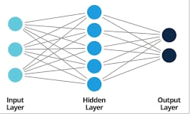
Neural Networks
Neural networks are computing systems with interconnected nodes that work much like neurons in the human brain. Using algorithms, they can recognize hidden patterns and correlations in raw data, cluster and classify it, and – over time – continuously learn and improve.

Slide 4
FEATURES
Date time
Temperature
Notepad
Music
You tube
Timesheet
Pencil sketch image
Chrome
Mailing
Internet speed
Shut down
Restart

Slide 5
Thank you

